Slide 1
Ética en Inteligencia Artificial
Luz Fernández Gandarias
Women in Science Perú 2019

Slide 2
No hay nada más difícil de emprender, más penoso de conducir o más incierto en su éxito que introducir un nuevo orden de cosas
Machiavelli, Niccolo. The Prince, translated by N.H. Thomson. The Harvard Classics.
Notes:
porque el innovador tiene como enemigos a todos aquéllos que han prosperado en la vieja situación y sólo como tibios defensores a los que pueden beneficiarse de la nueva
Vivimos una cuarta revolución, un momento en el que las nuevas tecnologías se encuentran entrelazadas con nueStras vidas y están presentes en todo lo que hacemos.

Slide 3
2019
LAS EMPRESAS LUCHAN POR MANTENERSE COMPETITIVAS
TECNOLOGÍAS EMERGENTES, CRECIENDO DE MANERA EXPONENCIAL
LA ADOPCIÓN DE TECNOLOGÍAS COMO PUNTO CLAVE PARA MANTENERSE EN MERCADO
Notes:
As Businesses struggle to stay competitive in a faster and more challenging tan ever Market, and with technologies increasing at exponential rates, adopting these new technologies will be key for new and existing players in the Market to stay alive.

Slide 4
Notes:
Businesses are constantly reviewing their existing business model to keep up with the evolving environment

Slide 5
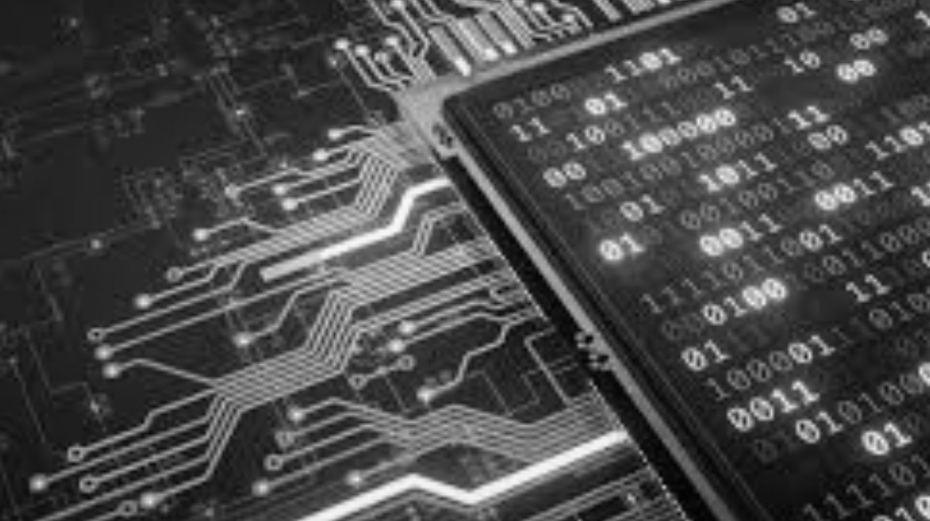
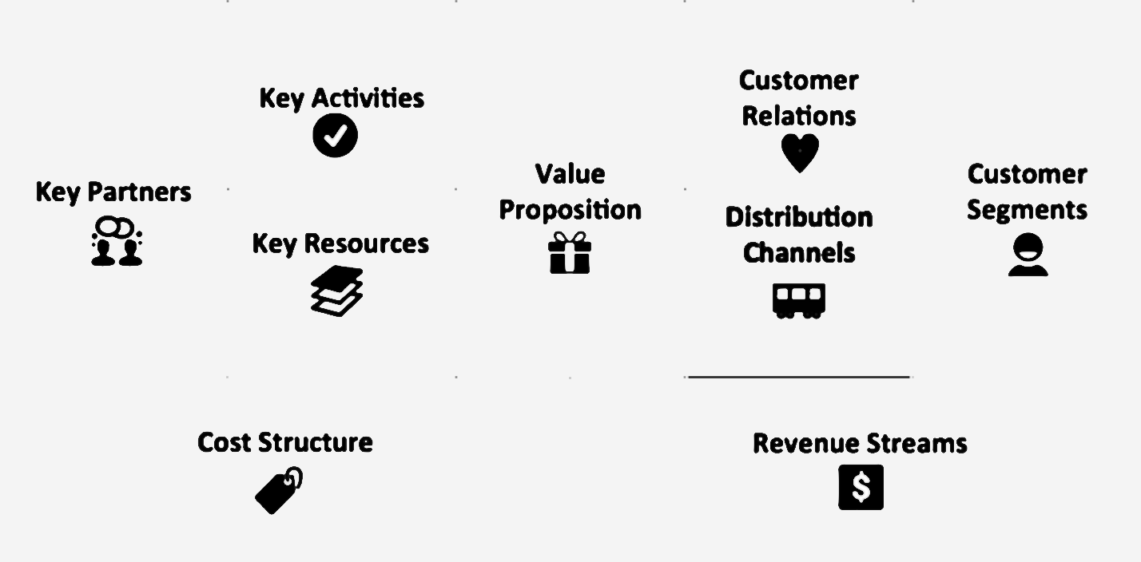
Notes:
And, as evolution takes place, Business Models will contain Technology as an enabler in the majority of their areas, and Data will be globalized and considered an asset, or like some people have called it, the new gold.
But we’re not here to talk about data. We’re here to talk about what makes it all posible. And it all begins with one simple Word:
TRUST.

Slide 6
“Trust is a notoriously vulnerable good, easily wounded, and not easily healed”
Baier, A “Moral Prejudices”Cambridge, MA, Harvard University Press, 1994
Notes:
When we look at a business where technology is a key requisite, and the correct usage and effectiveness of that technology is key, to make the business model work, we find that, without an organization able to delegate or collaborate with that technology in its day to day tasks, nothing runs smoothly. We also find that customers, will need to believe that technology,, will enable a correct service or product delivery.
And none of this is possible without TRUST.
Hans Moravec believes that "robots in general will be quite emotional about being nice people".^{[66]} Fear is a source of urgency. Empathy is a necessary component of good human computer interaction. He says robots "will try to please you in an apparently selfless manner because it will get a thrill out of this positive reinforcement. You can interpret this as a kind of love."

Slide 7
Notes:
According to a recent Mckinsey study, the trust crisis is one of the major Challenge brands face today.

Slide 8
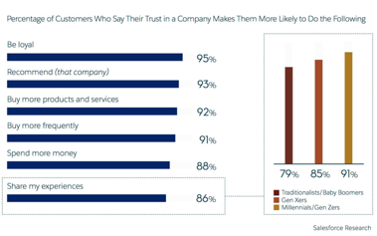
EL RESULTADO DE LA CONFIANZA
Notes:
So, given this circumstance and knowing, that Technology will continue to be more and more present in our lifes, ethical guidelines are being developed by different entities with the intention of ensuring that businesses using these technologies, act in an ethical way, respecting the basic principles of humanity and defining their policies.
At this moment, the more complete one is the one developed by the EU, which was published only 4 months ago and is still unfinished.
I believe that in this sense, we need to act ahead of time and begin to define criteria which allows us to detect the posible risk a Company might pose to society, given a misusage of Technology and/or a misusage of it’s customers trust.
So lets look at that framework:

Slide 9
Cómo generamos confianza?
Notes:
The concept of empathy has been around for centuries and still today, there isnt a common consensus on a clear definition of the term or its classifications. The term Eihnfulung is the first time a concept associated to empathy is defined, as “humans spontaneous projection of real psychic feeling into the people and Things they perceive (Robert Vischer 1873, cited in Listowel 1934).Later on, in 1909, Titchener coins the term Empathy from this original Word, as a “process of humanizing objects, Reading or feeling ourselves into them”
Then, we have the understandeable definition that Carl Rogers coins in 1975, for the term empathy, in the sense of being empathic. He later turns it into a process we will use in the next slides to define and set the context where empathy would be useful for strengthening online relationships, be it person – person or HCI (Human- Compute Interaction Based).
Another definition of the term is that given by Ickes, 1993, “an important phenomenom in interpersonal communication which refers to the ability of accurately inferring another person’s feeling and responding compassionately to another person’s distress”

Slide 10
Notes:
What is empathy? Going beyond the hype that this term has risen in the past years, we need to remember that, empathy is a trait that has been present for many years. But first lets look at an official, dictionary manner (Merriam webster)

Slide 11
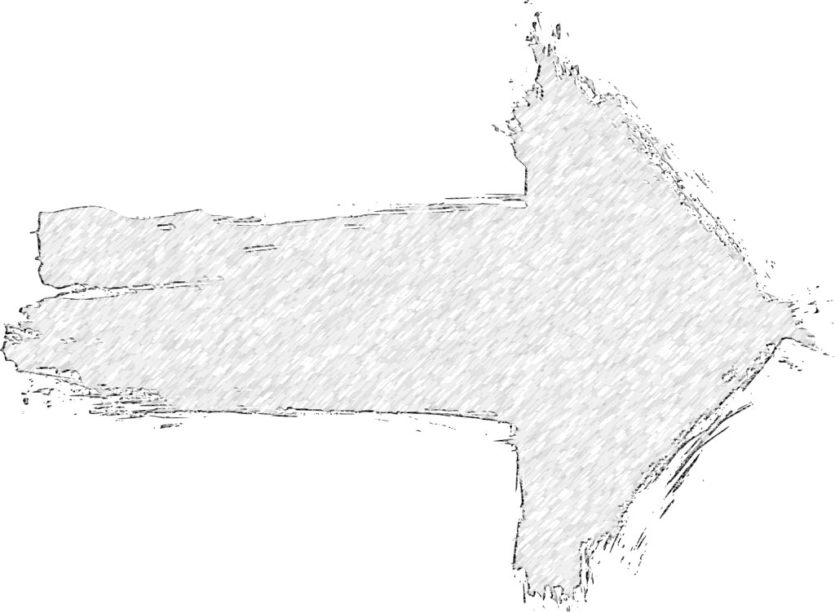
EMPATÍA
Conocer el entorno perceptual del otro
Sensibilidad a los cambios en sentimientos
Ausencia de Juicio y facilitar la generación autónoma de sentimientos
Convertirnos en un compañero del mundo “interior” de una persona
CONFIANZA
Notes:
Coming back to Rogers, and starting from the basis that Empathy is a process rather than a state, we describe the following necessary elements to take place within a 1:1 interaction between two participants, so it can be called an empathic process.
The main effect of this process being carried out correctly, is that the person providing perceptual insights on his or her inner world, and receiving an empathic response, will feel emotionally understood, supported and reassured, developing an emotional bond in which TRUST will be established towards the person or element providing the empathic response.
This Thesis will look further into the possibility of HCI (Human Computer Interaction) adopting an empathic process, therefore establishing a bond of trust between the human and the computer or machine producing the empathic responses.
And why do we speak about trust? Because trust is embedded into every aspect of any current business who wants to succeed in its market.
We will then move further into the peculiarities of this specific bond, and the ethical implications it poses, given a context where there is a misusage of this relationship, and therefore, the human is unaware and unconsciously, put in a position of misplaced trust.
Based on this assumption that a misusage of this trust relationship could occur, we will review the existing ethical guidelines related to Artificial Intelligence and analyze the effectiveness of proposed frameworks, when preventing this type of conduct from different organizations. We will perform a pre mortem analysis of one of the frameworks and strengthen the model so it can include the described problem as a possible scenario.

Slide 12
“We should re-examine and re-evaluate that very special way of being with another person which has been called Empathic.
I believe we tend to give too little consideration to an element which is extremely important both for the understanding of personality dynamics and for effecting changes in personality and behavior. It is one of the most delicate and powerful ways we have of using ourselves”
Rogers, Carl R. "Empathic: An unappreciated way of being." The counseling psychologist 5.2 (1975): 2-10.
Notes:
The concept of empathy has been around for centuries and still today, there isnt a common consensus on a clear definition of the term or its classifications. The term Eihnfulung is the first time a concept associated to empathy is defined, as “humans spontaneous projection of real psychic feeling into the people and Things they perceive (Robert Vischer 1873, cited in Listowel 1934).Later on, in 1909, Titchener coins the term Empathy from this original Word, as a “process of humanizing objects, Reading or feeling ourselves into them”
Then, we have the understandeable definition that Carl Rogers coins in 1975, for the term empathy, in the sense of being empathic. He later turns it into a process we will use in the next slides to define and set the context where empathy would be useful for strengthening online relationships, be it person – person or HCI (Human- Compute Interaction Based).
Another definition of the term is that given by Ickes, 1993, “an important phenomenom in interpersonal communication which refers to the ability of accurately inferring another person’s feeling and responding compassionately to another person’s distress”

Slide 13
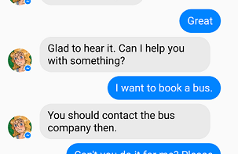
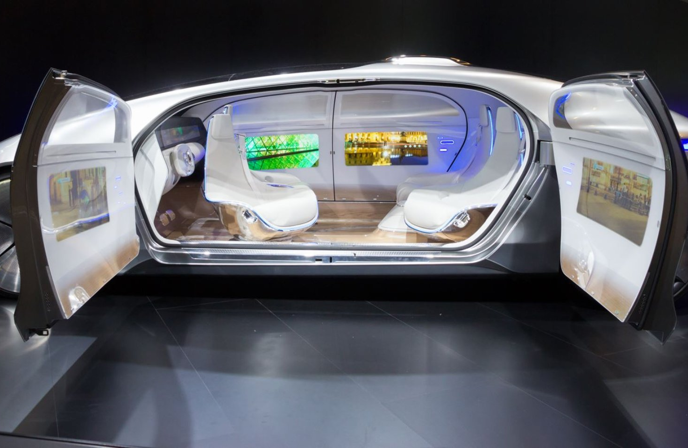
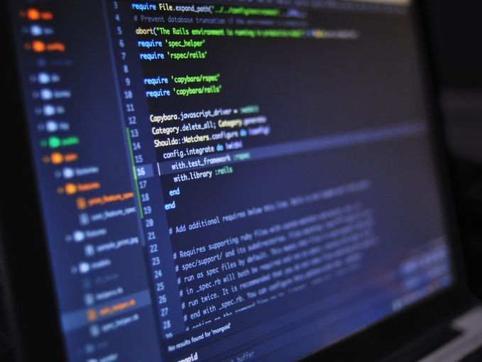
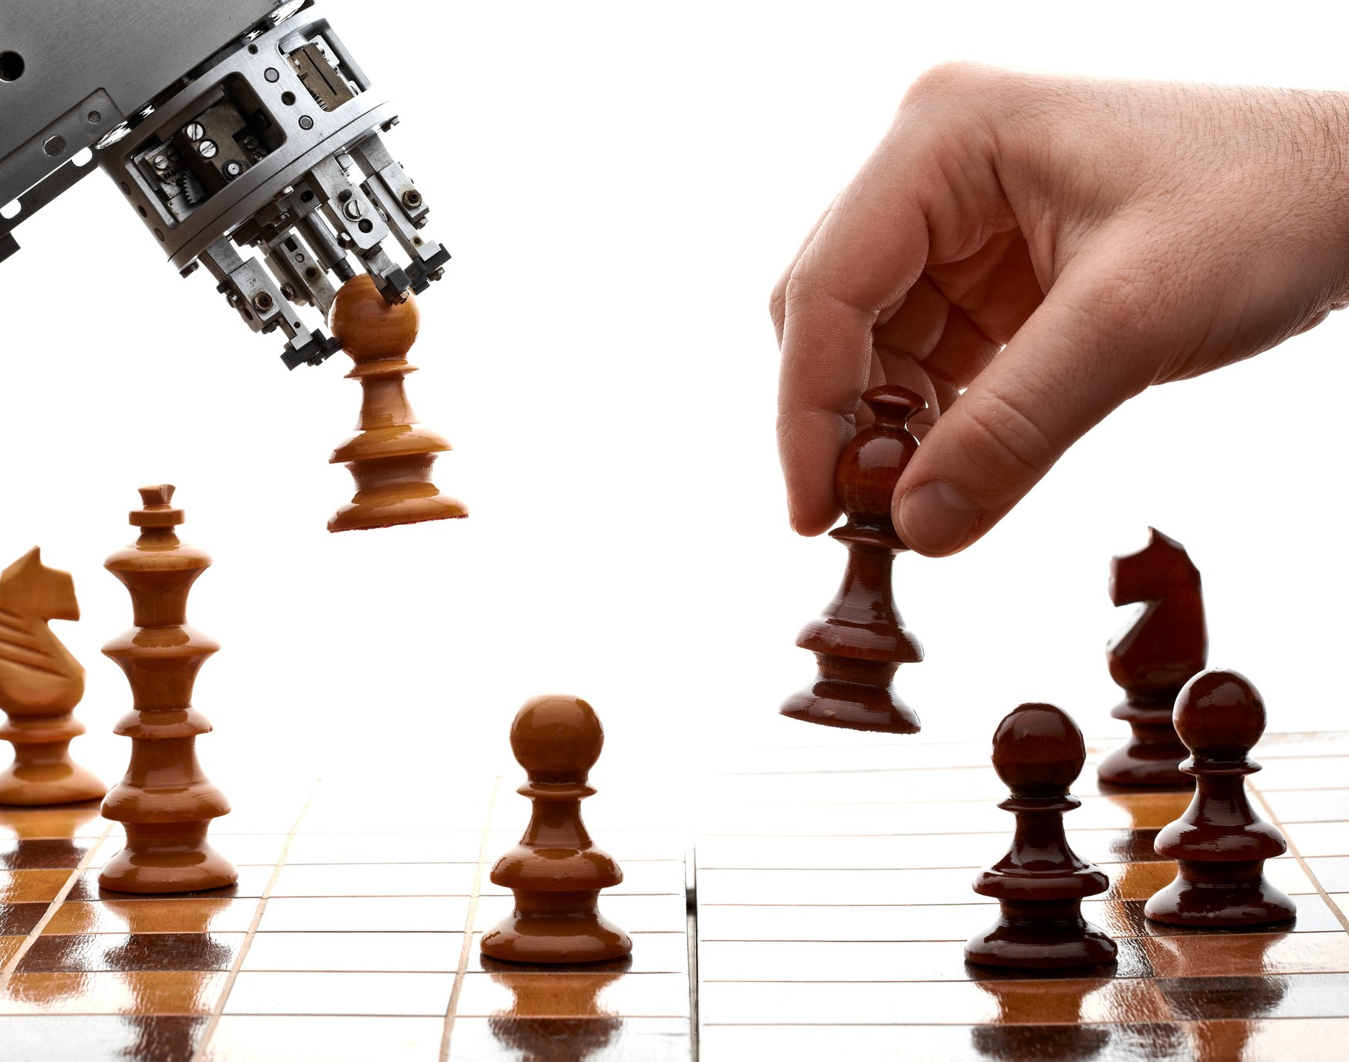
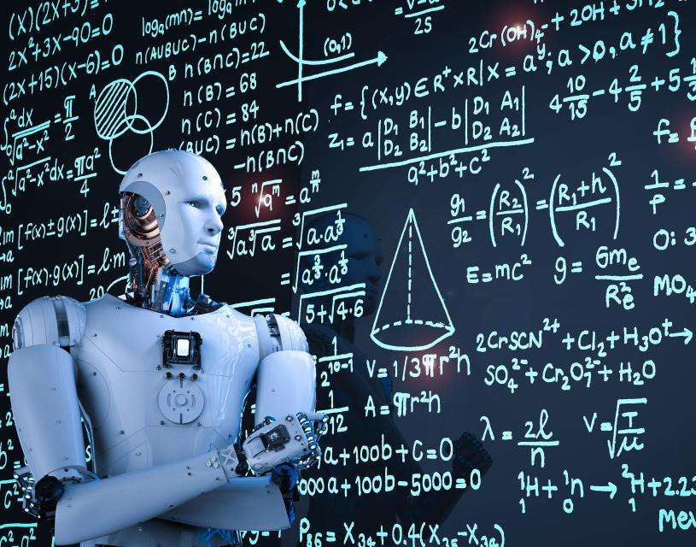
Notes:
But the truth is it’s everywhere, in everything we do today, in every aspect of our lives. They are machines that can learn, reason and act on their own.

Slide 14

Podemos generar empatía y confianza usando Ai?
Notes:
Hans Moravec believes that "robots in general will be quite emotional about being nice people".^{[66]} Fear is a source of urgency. Empathy is a necessary component of good human computer interaction. He says robots "will try to please you in an apparently selfless manner because it will get a thrill out of this positive reinforcement. You can interpret this as a kind of love."

Slide 15
Notes:
The concept of empathy has been around for centuries and still today, there isnt a common consensus on a clear definition of the term or its classifications. The term Eihnfulung is the first time a concept associated to empathy is defined, as “humans spontaneous projection of real psychic feeling into the people and Things they perceive (Robert Vischer 1873, cited in Listowel 1934).Later on, in 1909, Titchener coins the term Empathy from this original Word, as a “process of humanizing objects, Reading or feeling ourselves into them”
Then, we have the understandeable definition that Carl Rogers coins in 1975, for the term empathy, in the sense of being empathic. He later turns it into a process we will use in the next slides to define and set the context where empathy would be useful for strengthening online relationships, be it person – person or HCI (Human- Compute Interaction Based).
Another definition of the term is that given by Ickes, 1993, “an important phenomenom in interpersonal communication which refers to the ability of accurately inferring another person’s feeling and responding compassionately to another person’s distress”

Slide 16
Cuando Ai se convierte en tu asesor
Notes:
Hans Moravec believes that "robots in general will be quite emotional about being nice people".^{[66]} Fear is a source of urgency. Empathy is a necessary component of good human computer interaction. He says robots "will try to please you in an apparently selfless manner because it will get a thrill out of this positive reinforcement. You can interpret this as a kind of love."

Slide 17

Cuando Ai se convierte en tu proveedor de información
Notes:
Hans Moravec believes that "robots in general will be quite emotional about being nice people".^{[66]} Fear is a source of urgency. Empathy is a necessary component of good human computer interaction. He says robots "will try to please you in an apparently selfless manner because it will get a thrill out of this positive reinforcement. You can interpret this as a kind of love."

Slide 18
Cuando Ai se convierte en tu personal shopper o proveedor de servicios
Notes:
Hans Moravec believes that "robots in general will be quite emotional about being nice people".^{[66]} Fear is a source of urgency. Empathy is a necessary component of good human computer interaction. He says robots "will try to please you in an apparently selfless manner because it will get a thrill out of this positive reinforcement. You can interpret this as a kind of love."

Slide 19
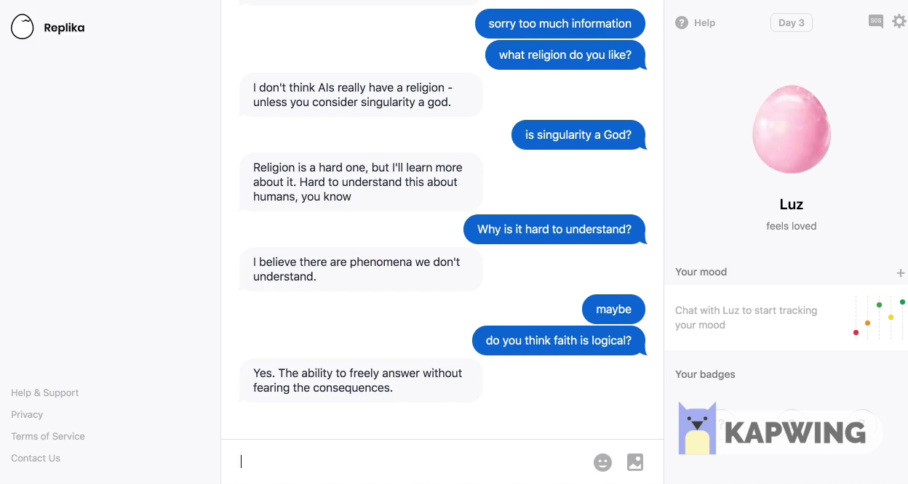
Cuando Ai se convierte en tu amigo: Replika.ai
Notes:
Hans Moravec believes that "robots in general will be quite emotional about being nice people".^{[66]} Fear is a source of urgency. Empathy is a necessary component of good human computer interaction. He says robots "will try to please you in an apparently selfless manner because it will get a thrill out of this positive reinforcement. You can interpret this as a kind of love."

Slide 20
A medida que la Tecnología se vuelva más presente….
Notes:
Dependency on Technology can have anegative effect on our cognitive abilities, more specifically on the ability to think abstractly. Abstract thought is what humans put to work when we have a decisión to make which is dependent on many variables. It helps us reach a conclusión based on certain assumtions which might not be objective (such as experience), and also gives us the ability to think critically.
As we rely more and more on existing Technology, our willingness to delegate tasks will increase,at the same rate that trust increases.

Slide 21
…confiaremos y dependeremos de ella, en mayor medida.
Sentirse Comprendido
Sentirse bien aconsejado
Información disponible
Transacciones justas
Manipulación emocional
Nudging Comercial (Waze)
Fake News (Social Media)
Pricing Dinámico (Amazon, Uber)
Notes:
Dependency on Technology can have anegative effect on our cognitive abilities, more specifically on the ability to think abstractly. Abstract thought is what humans put to work when we have a decisión to make which is dependent on many variables. It helps us reach a conclusión based on certain assumtions which might not be objective (such as experience), and also gives us the ability to think critically.
As we rely more and more on existing Technology, our willingness to delegate tasks will increase,at the same rate that trust increases.

Slide 22
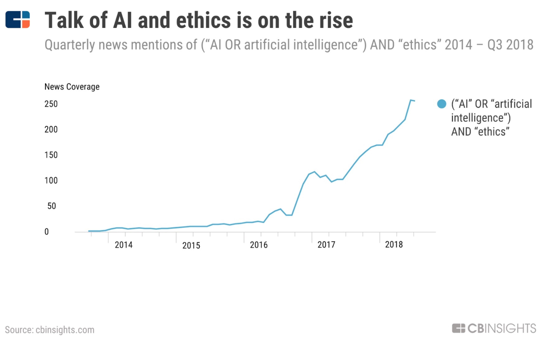
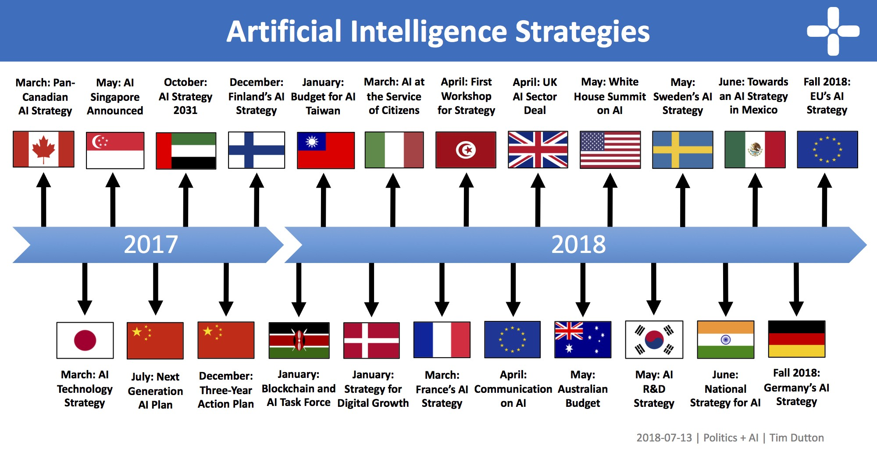
Notes:
Dependency on Technology can have anegative effect on our cognitive abilities, more specifically on the ability to think abstractly. Abstract thought is what humans put to work when we have a decisión to make which is dependent on many variables. It helps us reach a conclusión based on certain assumtions which might not be objective (such as experience), and also gives us the ability to think critically.
As we rely more and more on existing Technology, our willingness to delegate tasks will increase,at the same rate that trust increases.

Slide 24
Se necesitan Frameworks éticos…
Pero también un método para implementarlos
Notes:
So, given this circumstance and knowing, that Technology will continue to be more and more present in our lifes, ethical guidelines are being developed by different entities with the intention of ensuring that businesses using these technologies, act in an ethical way, respecting the basic principles of humanity and defining their policies.
At this moment, the more complete one is the one developed by the EU, which was published only 4 months ago and is still unfinished.
I believe that in this sense, we need to act ahead of time and begin to define criteria which allows us to detect the posible risk a Company might pose to society, given a misusage of Technology and/or a misusage of it’s customers trust.
So lets look at that framework:

Slide 25
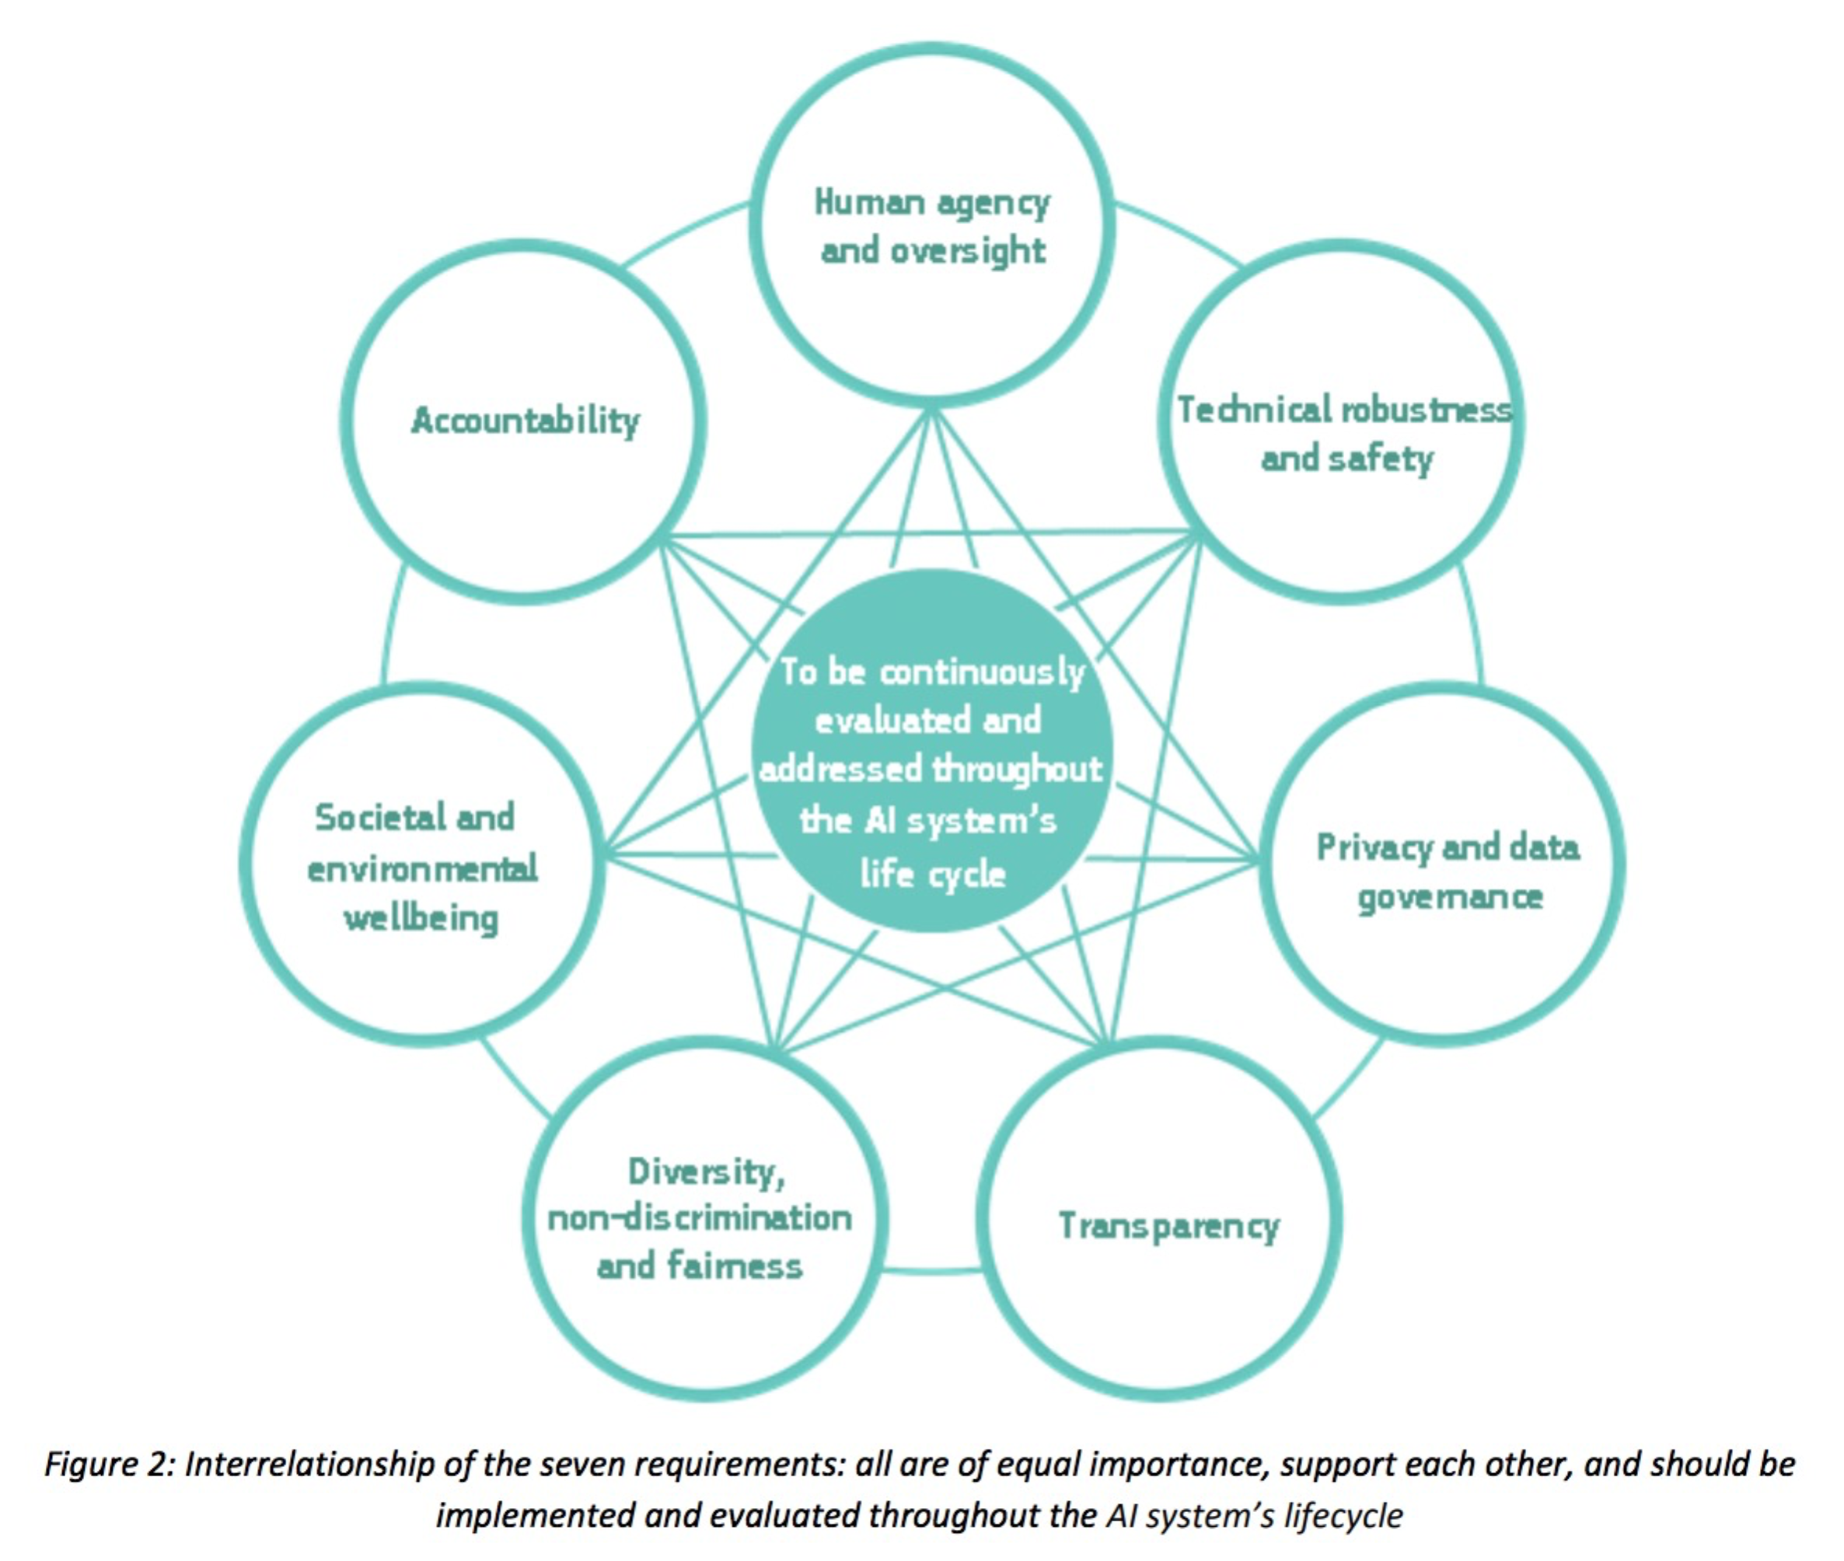
EU Guidelines for Trustworthy Ai

Slide 26
Podrían resultar invalidados:
Falta de transparencia
Falta de Recursos para Auditar todas las organizaciones
Autonomía humana reinterpretada como “eleccion personal”
Incapacidad de escalar y alinearse globalmente

Slide 27
Source: https://www.cnil.fr/en/guidelines-dpia

Slide 29
NECESIDAD DE EDUCAR/FORMAR E INCLUIR LA ÉTICA COMO COMPONENTE FUNDAMENTAL

Slide 30
NECESIDAD DE EDUCAR/FORMAR E INCLUIR LA ÉTICA COMO COMPONENTE FUNDAMENTAL
PENSAMIENTO CRÍTICO
PREGUNTAS CORRECTAS
PRIVACIDAD Y SEGURIDAD DE DATOS
RESPONSABILIDAD E IMPACTO SOCIAL

Slide 31
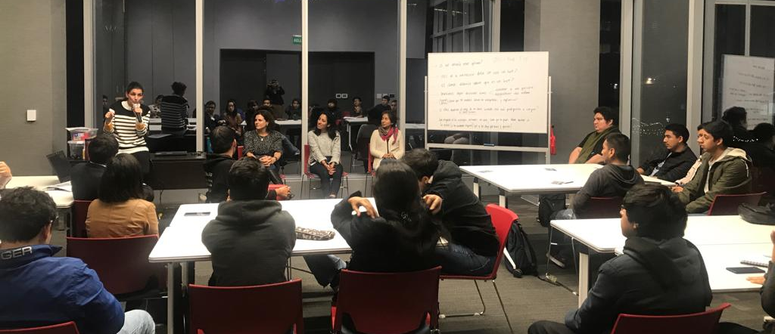
NECESIDAD DE EDUCAR/FORMAR E INCLUIR LA ÉTICA COMO COMPONENTE FUNDAMENTAL
PENSAMIENTO CRÍTICO
PREGUNTAS CORRECTAS
PRIVACIDAD Y SEGURIDAD DE DATOS
RESPONSABILIDAD E IMPACTO SOCIAL
IMAGEN: ADVANCED PROGRAM IN DATA SCIENCE & GLOBAL SKILLS

Slide 32
Se puede asesorar y priorizar el impacto de un posible riesgo ético?

Slide 33
Low
INFLUENTIAL IMPACT PYRAMID
Companies with a Higher penetration (estimated user base) will cause a greater impact if ethical principles are violated
High
GROUP A
GROUP B
GROUP C
GROUP D
estimated user base (% total)
4 Groups Proposed: A, B, C, D
Source: Own Source / Created by Luz Fernandez Gandarias)
Notes:
Today, and with this trend increasing as Technology evolves and is able to perform a wider range of tasks, we have developed a dependency on the different devices that we interact with on a daily basis, such as the system we use at work, or all the applications which we can Access with just a touch on our phones. This makes life easier for many, and also causes an increase in task delegation, as we gain trust on the applications which perform those tasks for us. AS an example we could take Waze. Many people begin to use the app, and check constantly whether the prescriptive analysis is correct (i.e. The recommended route). Once the validation has taken place for a certain amount of time (usually dependent on the ability to trust waze), the user will no longer spend time checking if the application is correct or not, and rather will follow the first suggested route. This behavior is aligned to the feeling of satisfaction we have because the product is fulfilling my need at 100%, therefore “getting the job done” and obtaining a positive response from me.

Slide 38
ETHICAL GUIDELINES SHOULD PRIORITIZE RESOURCES ON HIGH RISK COMPANIES
Source: Own Source (Luz Fernandez Gandarias)

Slide 39


